Slide 1
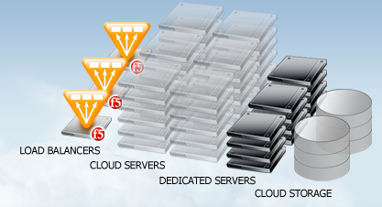
Infrastructure-as-a-Service

Slide 2
IaaS Vendors
Amazon AWS
Rackspace
Gogrid
Terremark
Softlayer
Indian Market
Netmagic
Tata InstaCloud

Slide 3
IaaS Considerations - 1
Support & HelpDesk
email, phone, 24x7
Hardware & Performance
Operating System Support
Distribution versions and range of support
Imaging of server?
Distribution and re-selling of images?
Software availability and partner network
Middleware?
Database layer?
For example, Amazon EC2 has partnered with IBM, Symantec, Microsoft, Redhat, Oracle, etc. to provide a wide variety of pre-packaged software

Slide 4
IaaS Considerations - 2
APIs / Ecosystem
Bindings in various languages – maintenance, backward compatibility
Tools and ecosystem
Licensing
Can be a problem
Brings limitations to cloud migration
Ex: IBM Websphere clustering not available on EC2
Ex: Windows licenses cannot be migrated from local datacenter to cloud
Other services
Databases storage, backups, monitoring, auto-scaling, load-balancing, messaging, etc.

Slide 5
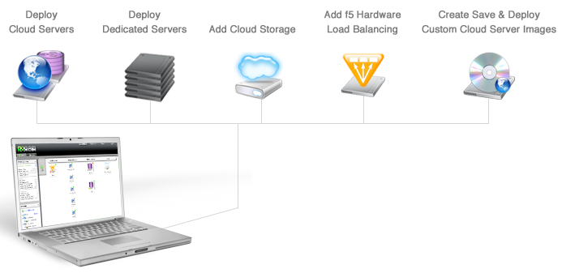
GoGrid
Vertical RAM Scaling
Hardware firewall

Slide 6
IaaS Service APIs
Let’s look at GoGrid’s APIs
Server Methods
List servers
Get server
Add servers
Edit server
Delete server
Start, stop or restart server
Server Image Methods
List Images
Get Image
Edit Image
Save Image
Delete Image
Restore Image
Loadbalancer Methods
List
Get
Add
Edit
Delete
IP Methods
List all unassigned, assigned, private & public Ips
Utility
Lookup Lists

Slide 7
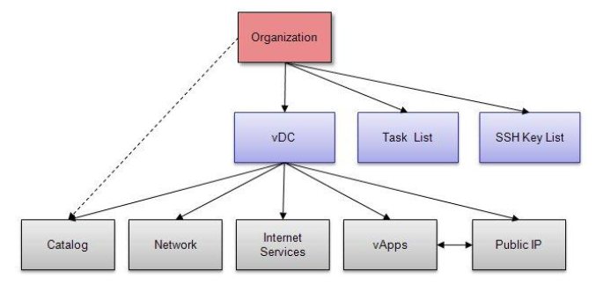
Terremark APIs

Slide 8
Let’s compare IaaS Platforms
 | OS Support | Disk Persistence | Choice of resources | Tools / Ecosystem | Hosting | Services | Perform-ance
Amazon AWS | Good but not flexible | Yes & No | Medium | Extensive – by a long way | Ideal | Extensive | ?
Rackspace | Limited | Yes | Limited | Good | Good | Very Limited | ?
GoGrid | Limited but growing | Yes | Limited | Medium | Good | Limited | ?
Terremark | Extensive & Flexible | Yes | Extensive | Very limited | Not good | Limited | ?
Performance needs to be tested for various applications across vendors.
Lot of variation depending on CPU, network or disk bound application.

Slide 9
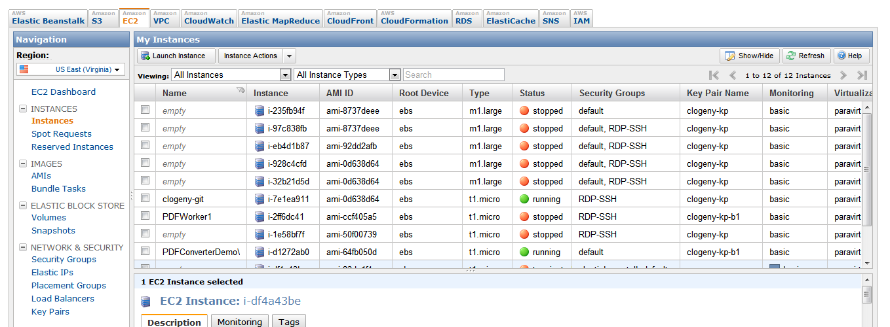
AWS Management Portal

Slide 10
Hybrid / Federated Clouds
OS Images
Hybrid Cloud
Applications
Control
Data
Management
Management
Bridge
Virtualization Infrastructure
Virtualization Infrastructure
Public Clouds
Private Clouds

